Slide 1
Resource
CareTeam
identifier
status
category
name
subject
period
participant
role
member
period
managingOrganization

Slide 2
Shared Care Team
careTeam (Allied providers Team)
identifier
status
category
….
participant
careTeam (PCP Team)
identifier
status
category
….
participant
careTeam (caregiver team)
identifier
status
category
….
participant
Non-carePlan careTeam (Community based Team)
identifier
status
category
….
participant
Non-carePlan careTeam (ACT Team)
identifier
status
category
….
participant
careTeam (inpatient Team)
identifier
status
category
….
participant
careTeam (Specialist Team)
identifier
status
category
….
participant
careTeam (ED Team)
identifier
status
category
….
participant

Slide 3
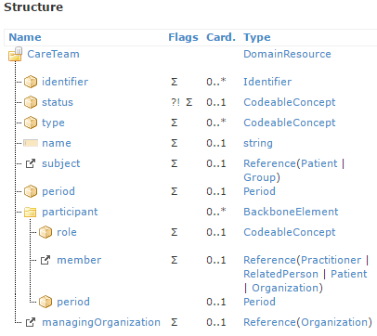
Care Team Resource - structure
FHIR description:
Identifies what kind of team.
This is to support differentiation between multiple co-existing teams, such as:
care plan team
episode of care team
longitudinal care team
FHIR has not defined a formal value set for care team type the care team type examples in FHIR documentation
aligns quite well with the types defined by the Care Team definition project:
Encounter focused
Episode of care focused
Condition focused
Care coordination focused
Oncology care team
medical oncology
surgical oncology
allied health
oncology social service
home care team
support service team
Cardiology care team
CF tertiary care team
CF community based care team
Palliative care
…
* Episode of care focused
CF tertiary care team
* Care coordination focused
Oncology care team
* Care coordination focused
Respiratory care team
Issue: Current FHIR Care Team does not provide structure/”home”
for clinical and support function care teams
Possible option – allow 0..* values on CareTeam.type element
Example – for patient with breast cancer:
Care coordination focused
Oncology care team

